Slide 1
Residual Networks & Densly Connected Convolutional Networks
Alexander Bierenstiel
Deep Learning Seminar WS19/20
8. January 2020

Slide 2
Outline
ResNet (published 2015)
Architecture
Properties
DenseNet (published 2018)
Architecture
Properties
Experiments

Slide 3
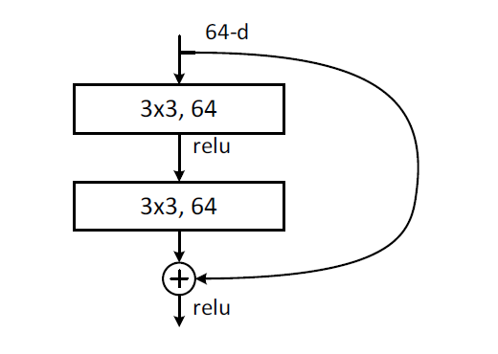


ResNet Residual Unit
$H(x)$ old mapping
$$H\left(x\right)$$
Source: (modified) Paper „Deep Residual Learning for Image Recognition”

Slide 4


ResNet Residual Unit
$H(x)$ old mapping
$x$ skip connection / identity
$$H\left(x\right)$$
$$x$$
Source: (modified) Paper „Deep Residual Learning for Image Recognition”

Slide 5


ResNet Residual Unit
$H(x)$ old mapping
$x$ skip connection / identity
$F\left(x\right)$ new mapping with skip connection
$$H\left(x\right)$$
$$x$$
$$F\left(x\right)≔H\left(x\right)−x$$
Source: (modified) Paper „Deep Residual Learning for Image Recognition”

Slide 6
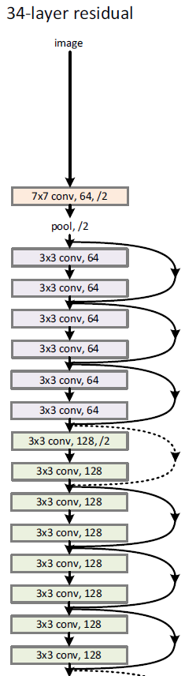
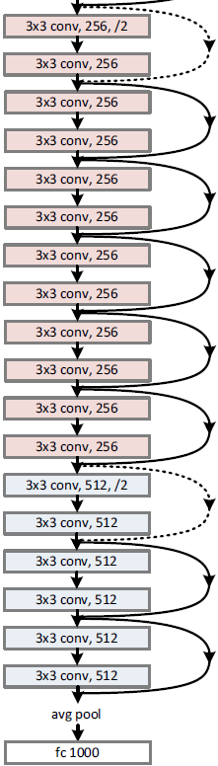
ResNet Architecture
Source: „Deep Residual Learning for Image Recognition”

Slide 7
ResNet Gradient Flow
Improved gradient flow
through skip connections
Source: (modified) Paper „Deep Residual Learning for Image Recognition”

Slide 8
ResNet Properties
Improved gradient flow
Less prone to vanishing gradients
Deeper networks are trainable
Feauture propagation through skip connections
Skip connections are computationally cheap

Slide 9
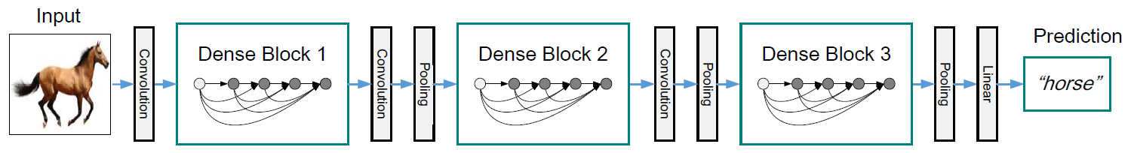
DenseNet Architecture
Transition layer:
Reduce number of feature maps,
Reduce width and height of feature maps
Create new feature maps and concatenate them
Source: Paper „Densely Connected Convolutional Networks“

Slide 10

DenseNet Architecture II
$H(∙)$ Composite function (Batch Norm., ReLU, Conv., Pooling) e.g. Transition layer:
$$H\left(x_{l}\right)=Conv\left(Pooling\left(x_{l}\right)\right)$$
ResNet: $x_{l}=H_{l}\left(x_{l−1}\right)+x_{l−1}$
DenseNet: $x_{l}=H_{l}\left(\left[x_{0}, x_{1}, …, x_{l−1}\right]\right)$

Slide 11
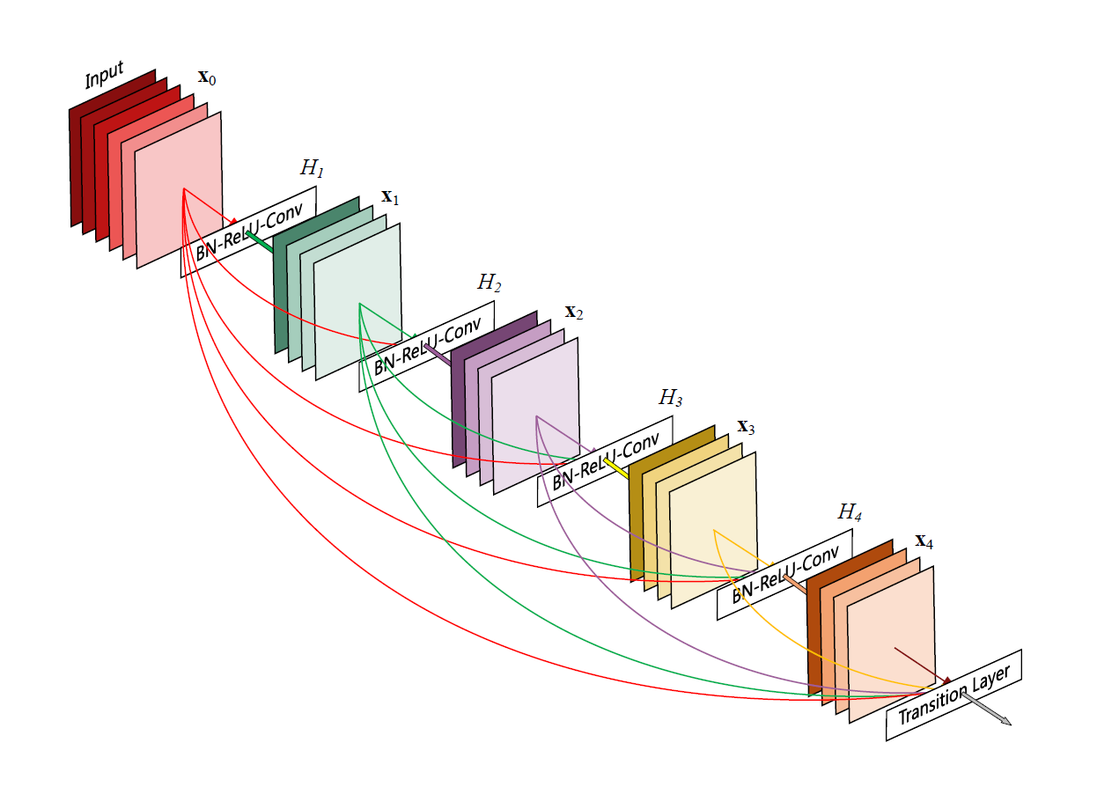
DenseNet Dense Block Architecture
convolution filters
Source: Paper „Densely Connected Convolutional Networks“

Slide 12
DenseNet Gradient Flow
ordinary gradient flow
improved gradient flow through many skip connections
Source: Paper „Densely Connected Convolutional Networks“

Slide 13
DenseNet Properties
Similarities compared to ResNet:
Uses skip connections
Less prone to vanishing gradients
Differences compared to ResNet:
Deeper networks are trainable
Less parameters to learn
Less filters per convolution layer
Combine feature maps by concatenation
Enables feature reuse
Better accuracy

Slide 14
Experiments

Slide 15
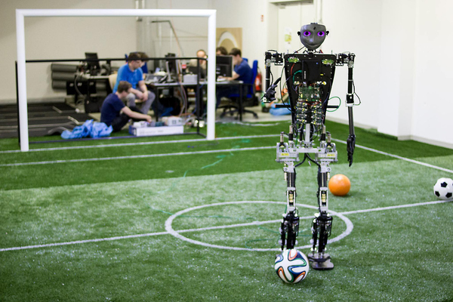
Dataset
Data from HS Offenburg Sweaty team
Small dataset excerpt:
8 Classes
4917 Training images
1230 Test images
Source: https://sweaty.hs-offenburg.de/projekt/
Notes:
Default-Konfiguration für alle Experimente
Model
ResNet-50 vortrainiert für ImageNet
Optimizer
Adam
Loss-Funktion
Categorical Crossentropy
Metriken
Accuracy, Categorical Accuracy
Train Batch Size
10
Test Batch Size
10
Epochen
50

Slide 16








Dataset
Ball | Goal post | Obstacle | L-Line
X-Line | T-Line | Penalty spot | Robot foot

Slide 17
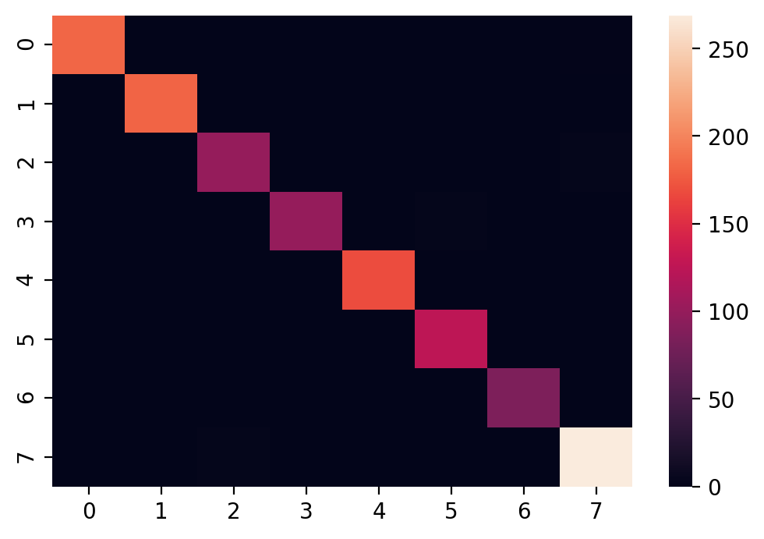
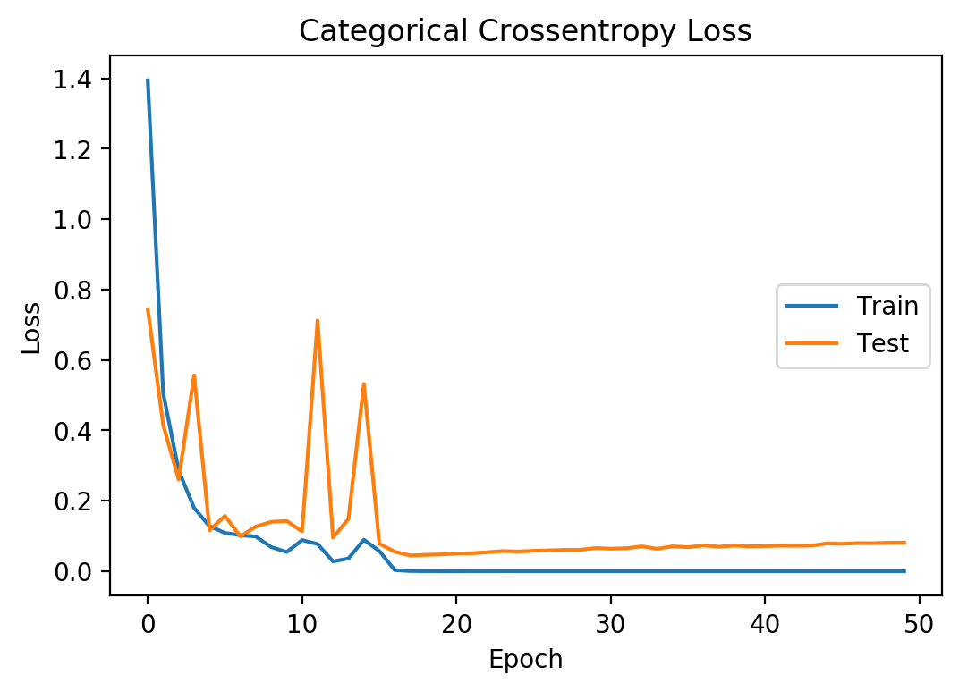
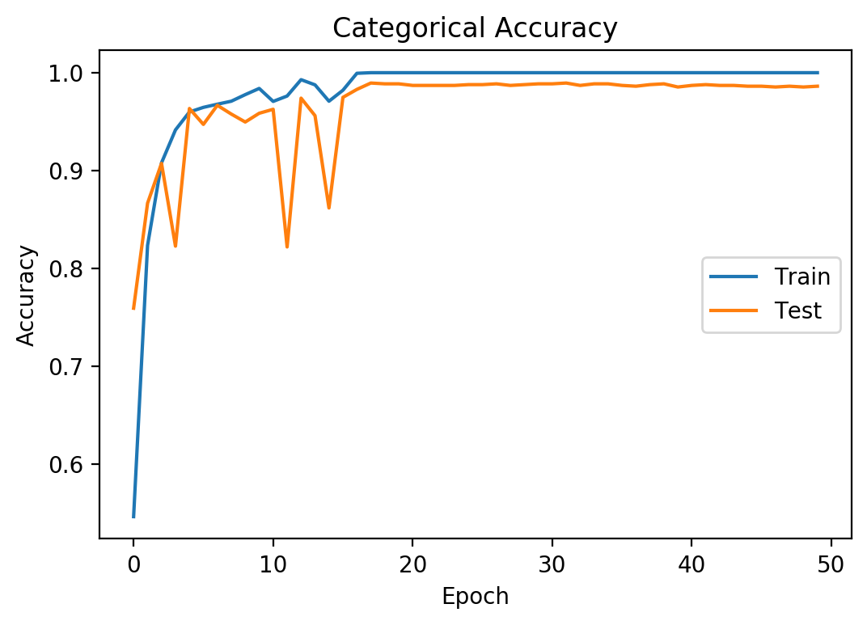
ResNet-50 Performance Overview
2,5 h Training time
1230 Test images
17 False predictions
1,38% Error rate

Slide 18






ResNet-50 Performance False Predictions
Robot foot (Ball) | Goal post | Goal post (Obstacle) | T-Line (L-Line)
Robot foot (X-Line) | Goal post (T-Line) | Penalty spot | Obstacle (Robot foot)
✔
✔

Slide 19
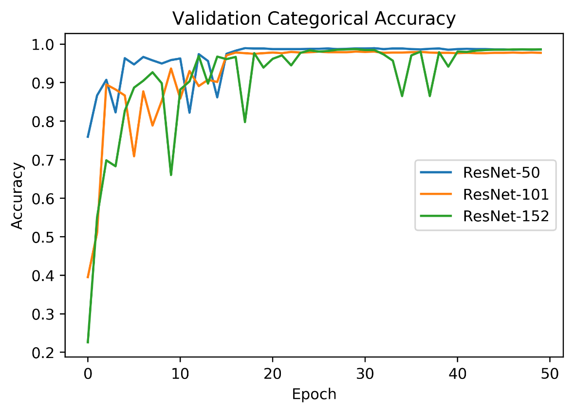
ResNet-50 -101 - 152
Notes:
Comparing ResNet-152 with DenseNet-169
Comparing models with almost equal height
Show Learning curve
To answer the question: „Does ResNet or DenseNet perform better with almost equal network heights“
TODO: Verify that both network actually have almost the same height

Slide 20
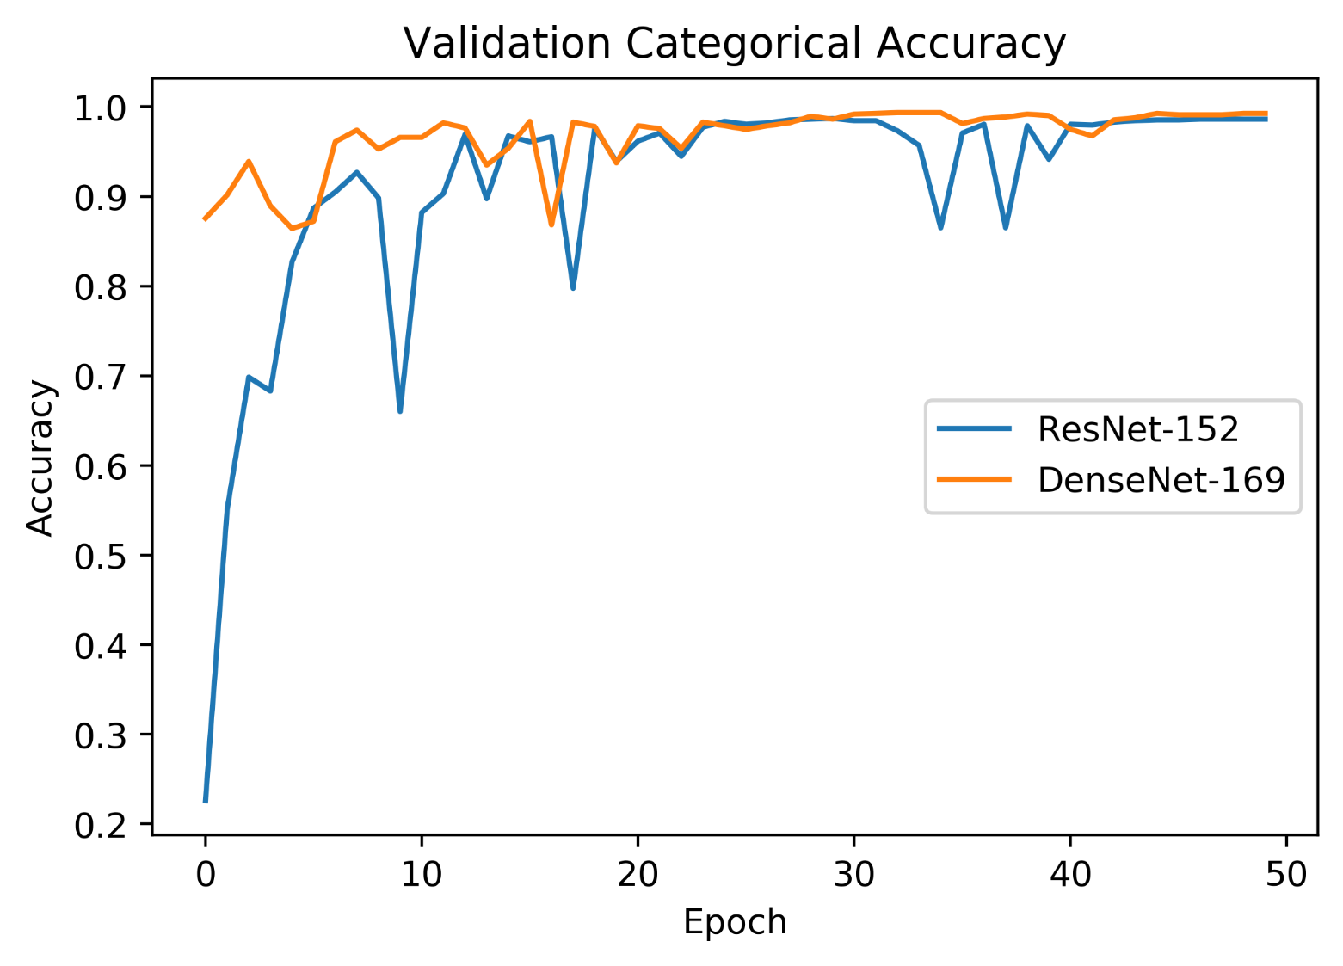
ResNet-152 & DenseNet-169
Notes:
Comparing ResNet-152 with DenseNet-169
Comparing models with almost equal height
Show Learning curve
To answer the question: „Does ResNet or DenseNet perform better with almost equal network heights“
TODO: Verify that both network actually have almost the same height

Slide 21
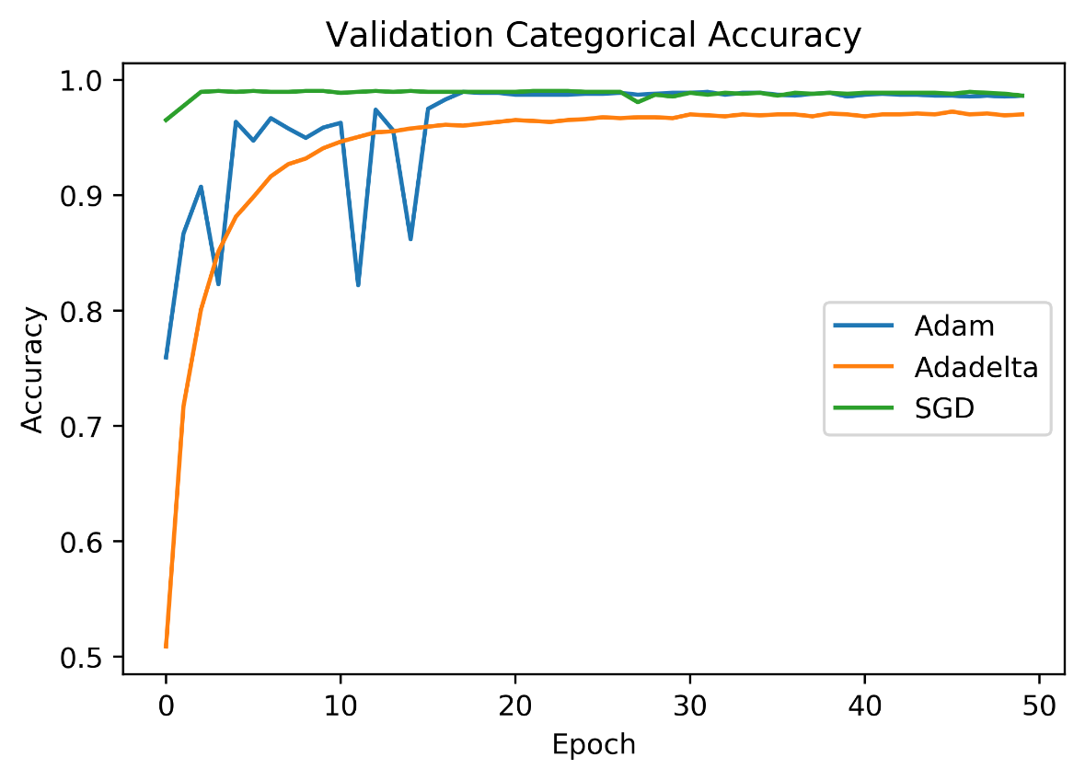
Optimizers
Notes:
Comparing the optimizers:
Keras Default Adam (Default)
Keras Default Stochastic Gradient Descent
Keras Default Adadelta
Learning with model ResNet-50 (default)
Showing Learning Curve
To answer the question: „How does the training of the network behave with different optimizers?“

Slide 22
Summary
Deeper networks are trainable
ResNet: through skip connections
DenseNet: through many skip connections in dense units
Skip connections allow the gradients to flow better
Skip connections „artificially flatten the network“ such that deeper models are trainable
DenseNet improves ResNet
Better information flow (concatenation of feature maps)
Even more deeper networks possible (many skip connections in dense blocks)
Less parmeters to learn (less filters per convolution layer)
Better accuracy
Notes:
Comparing the optimizers:
Keras Default Adam (Default)
Keras Default Stochastic Gradient Descent
Keras Default Adadelta
Learning with model ResNet-50 (default)
Showing Learning Curve
To answer the question: „How does the training of the network behave with different optimizers?“

Slide 23
Literature
Colab Notebook:
https://github.com/abieren/DL-Seminar-ResNet-DenseNet
Source code and documentation:
Keras ResNet Documentation https://keras.io/applications/#resnet
“Tutorial Keras: Transfer Learning with ResNet50” https://www.kaggle.com/suniliitb96/tutorial-keras-transfer-learning-with-resnet50
GitHub: „How to add and remove new layers in keras after loading weights?” https://stackoverflow.com/questions/41668813/how-to-add-and-remove-new-layers-in-keras-after-loading-weights
ResNet Paper: „Deep Residual Learning for Image Recognition” https://arxiv.org/abs/1512.03385
DenseNet Paper: „Densely Connected Convolutional Networks“ https://arxiv.org/abs/1608.06993
Sweaty HS Offenburg: https://sweaty.hs-offenburg.de/projekt/

